Slide 1

See-Food Service Supreme (SFSS)
Castro, Rolf Sheehan
Gray, Haley
Juneja, Kunal
Suarez, Nathaniel

Slide 2

Introduction
See (Visual Perception) - “One of the five senses, it is one of the abilities to interpret the surrounding environment using light in the visible spectrum.”
Link:
https://en.wikipedia.org/wiki/Visual_perception
Food – “any substance consumed to provide nutritional support for the body.”
Link: https://en.wikipedia.org/wiki/Food
Supreme adjective - “superior to all others” synonyms: highest-ranking, head, top, superior, prime

Slide 3
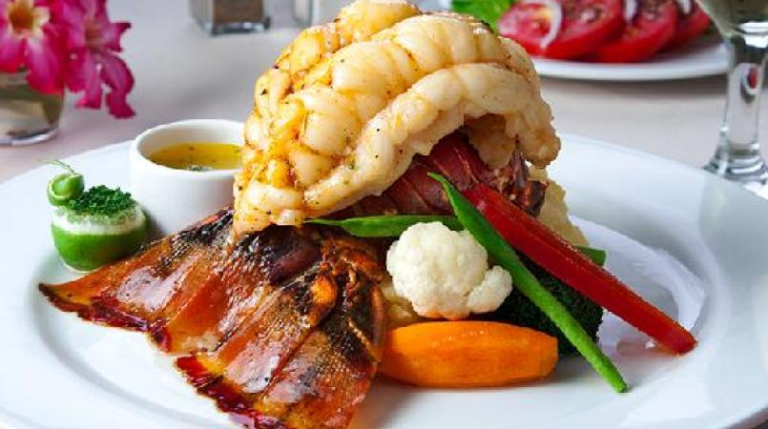
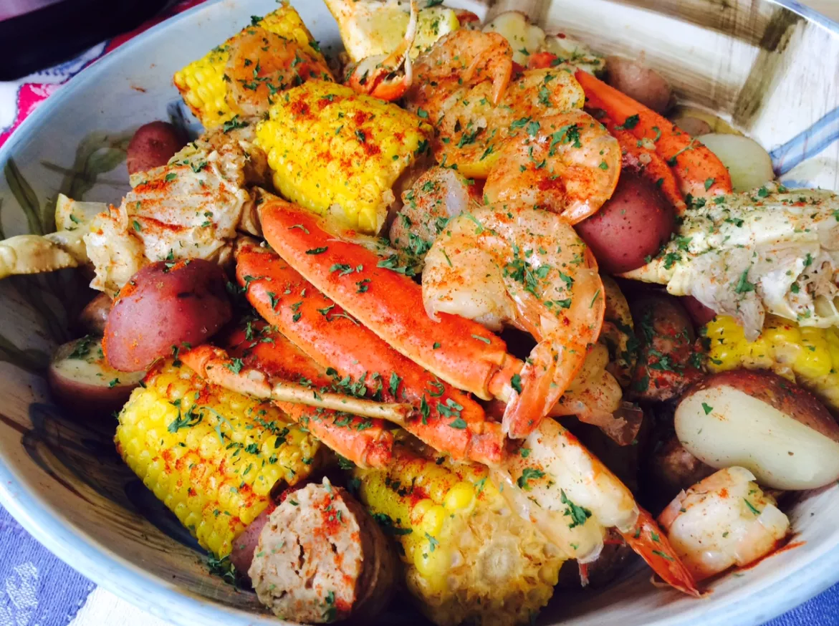
What is it for?
Fast and easy online shopping services for prime See-Food
Fresh and high-quality See-Food from different parts of the world
Online shopping for fresh produce delivered overnight to your door

Slide 4

Our Goal
To provide an online website for users to register for an account, place orders, track orders, and review order history
Provide a live-feed video of our livestock for users to pick and choose from

Slide 5
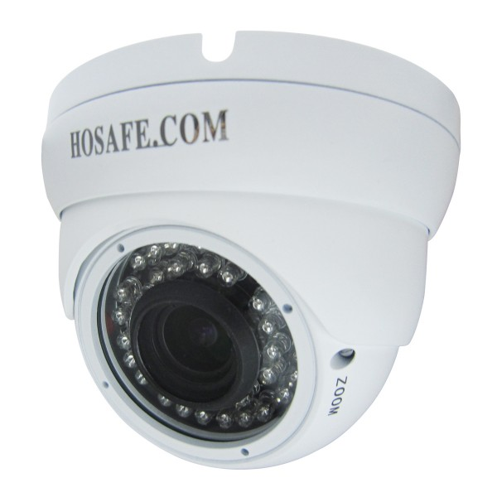
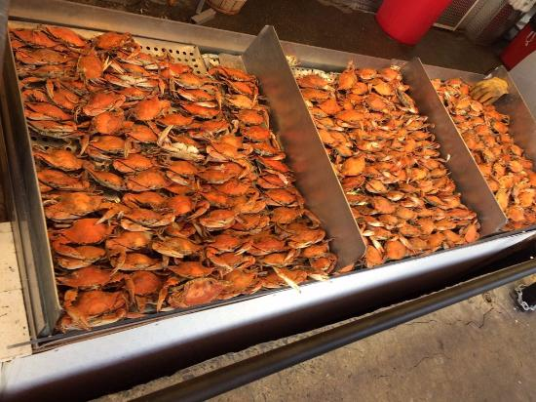
Our System’s Features
View a live feed of seafood
Order food from home using the website
Shipping the product to the user’s home
Tracking the order

Slide 6
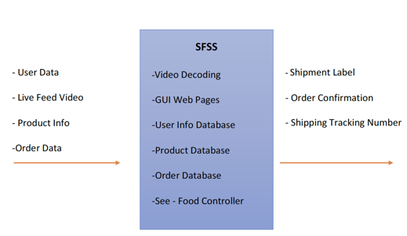
DFD Level 0

Slide 7
DFD Level 1
User Interface
User Interface
User Interface
User Interface
User Interface
New
Order
Data
Shopping Cart Data
Shopping Cart Data
User Login Data
User
Register
Data
Order
Data
Shopping Cart Module
Shopping Cart Data
new registered
user data
Login Module
Registration
Module
Order Module
New Order Data
Order Confirmation Module
Update
Retrieve
Retrieve
See-Food
Controller
Retrieve
Order
Data[3]
Customer Data[1]
Retrieve
Update
Update
New
Product Data
Product Selection Module
Product Data
User Interface
Order Data
User Interface
Retrieve
Retrieve
Product Upload Module
Live Feed
Video Data
User Interface
Shipping Module
User Interface
Retrieve
Live Camera Feed Module
Shipping
Data
Update
Live Feed
Video Data
Printer
Product Data[2]
Live Camera Feed

Slide 8
See-Food Controller (SFC)
Allows vendor to view and process web-based customer and order data from a locally running, centralized software application.
Connects modules together and allows the vendor access to data.
Provides the module process interfaces for the vendor to view, add, update & delete from the Customer, Order, and Inventory databases.

Slide 9
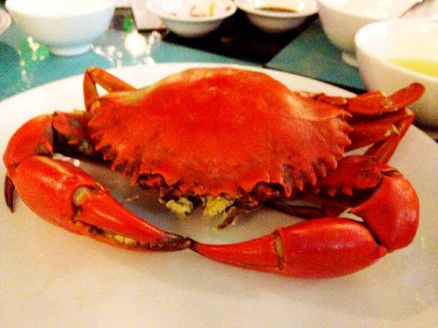

Product Selection Module
Provides a method for the user to retrieve information pertaining a specific product that is seen in the live feed camera.
Along with the live feed camera, the module will list products currently available.
Each product would have a unique product ID placed on the body that is visible in the live camera feed. The user can use product ID to get more information about a product.
A form with a text field allows the user to input a product ID (as seen from the live feed)
The user’s input queries the product database. If the product ID is valid, the data pertaining to that product ID (such as weight, length & date of arrival) is displayed back to user.
If the product ID is not valid, the user receives an error message.

Slide 10

Product Upload Module
With the Product Upload Module, it is in charge of keeping the products, that are in stock, organized.
It allows the vendor to see what is currently in stock and what products are out of stock.
It sends product information to the See-Food Controller so that the users who are browsing what products to purchase can have a more detailed description/information straight from the database.

Slide 11
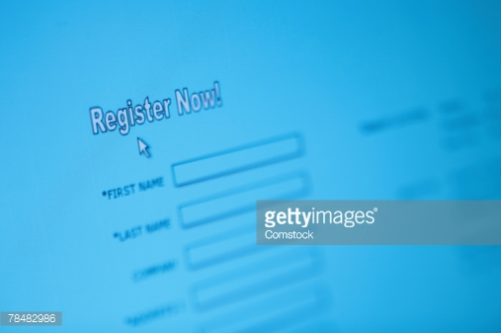

Registration Module
Creates a new user which can store user data to allow viewing of past and present orders.
Works with the Login Module, in which that it validates user login if a user that has registered is found.
Also allows the user for adding, editing, and/or deleting of their own user data. Adding, editing, and/or deleting includes:
Change/add/deletion of address, mailing address, phone numbers, payment information, and user name.
<2 images here>

Slide 12


Order Module
The Order Module allows the user to place fresh See-Food products into their own personalized Shopping Carts.
This module also interacts with the Order Confirmation and Shopping Cart Modules to verify the orders the user has placed in their Shopping Cart.

Slide 13
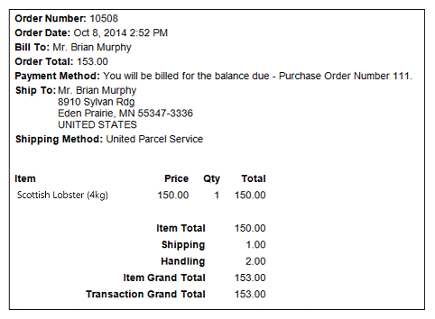
Order Confirmation Module
The Order Module provides the user their product receipt after their order has been placed.
Allows user to print or send their product receipt to their email.
This module then adds the order to the Product Data for recording the user’s activity.
It is to allow the user to view and check the status of their orders.
Also allows the users to view past orders.
This module also interacts with the See-Food Controller to redirect the user back to the home page of the website after they are done reviewing their product receipt.

Slide 14


Live Camera Feed Module
Live Camera Feed Module will provide a live feed of See-Food products to users, displaying the always-fresh-Seafood of See-Food Service Supreme!
It interacts with the See-Food Controller so that the user can navigate through different live feed cameras to see their desired See-Food product.

Slide 15

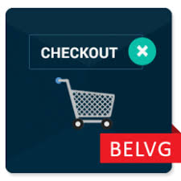
Shopping Cart Module
The Shopping Cart Module helps the user to view or edit their Shopping Cart.
The module will also help the users to add or delete any item as they like.
When the users have finalized their products then the module would allow them to checkout their products.
The module will also provide the user with many options of payment method and user could choose any one of them as they wish.

Slide 16


Shipping Module
The Shipping Module would be linked with the registration module for accessing the user's shipping information.
The module would also prompt to the user if they want to make any changes to the shipping address.
When the users have ordered their products, the module would then print the shipping label with tracking number using the label printer.
The tracking number then would be saved in the database.

Slide 17
Backup Slides
None.

